Slide 1
“Engaging Students for Mastery of Common Core Standards in 3rd Grade Multiplication and Division”
Myranda Robinson and Karli Mann University of Mary

Slide 2
http://sampleitems.smarterbalanced.org/itempreview/sbac/index.htm

Slide 3
http://sampleitems.smarterbalanced.org/itempreview/sbac/index.htm

Slide 4
What is Smarter Balanced?
http://www.smarterbalanced.org/sample-items-and-performance-tasks/
Sample test questions
Tool bar: grade level, content, and question type
An accurate depiction of standardized tests
Explains what standard(s) the question is measuring

Slide 5
How Did We Use Our Standard?
3. oa.c.7 Fluently multiply and divide within 100, using strategies such as the relationship between multiplication and division
Unpacking the standard
Making it manageable for both students and teachers
Objectives: Assure measurability
Use of verbs
“Skill-based”
Using manipulatives
More formative assessments

Slide 6
Multiplication Table
 | 0 | 1 | 2 | 3 | 4 | 5 | 6 | 7 | 8 | 9 | 10
0 | 0 | 0 | 0 | 0 | 0 | 0 | 0 | 0 | 0 | 0 | 0
1 | 0 | 1 | 2 | 3 | 4 | 5 | 6 | 7 | 8 | 9 | 10
2 | 0 | 2 | 4 | 6 | 8 | 10 | 12 | 14 | 16 | 18 | 20
3 | 0 | 3 | 6 | 9 | 12 | 15 | 18 | 21 | 24 | 27 | 30
4 | 0 | 4 | 8 | 12 | 16 | 20 | 24 | 28 | 32 | 36 | 40
5 | 0 | 5 | 10 | 15 | 20 | 25 | 30 | 35 | 40 | 45 | 50
6 | 0 | 6 | 12 | 18 | 24 | 30 | 36 | 42 | 48 | 54 | 60
7 | 0 | 7 | 14 | 21 | 28 | 35 | 42 | 49 | 56 | 63 | 70
8 | 0 | 8 | 16 | 24 | 32 | 40 | 48 | 56 | 64 | 72 | 80
9 | 0 | 9 | 18 | 27 | 36 | 45 | 54 | 63 | 72 | 81 | 90
10 | 0 | 10 | 20 | 30 | 40 | 50 | 60 | 70 | 80 | 90 | 100

Slide 7
Multiplication Table
 | 0 | 1 | 2 | 3 | 4 | 5 | 6 | 7 | 8 | 9 | 10
0 | 0 | 0 | 0 | 0 | 0 | 0 | 0 | 0 | 0 | 0 | 0
1 | 0 | 1 | 2 | 3 | 4 | 5 | 6 | 7 | 8 | 9 | 10
2 | 0 | 2 | 4 | 6 | 8 | 10 | 12 | 14 | 16 | 18 | 20
3 | 0 | 3 | 6 | 9 | 12 | 15 | 18 | 21 | 24 | 27 | 30
4 | 0 | 4 | 8 | 12 | 16 | 20 | 24 | 28 | 32 | 36 | 40
5 | 0 | 5 | 10 | 15 | 20 | 25 | 30 | 35 | 40 | 45 | 50
6 | 0 | 6 | 12 | 18 | 24 | 30 | 36 | 42 | 48 | 54 | 60
7 | 0 | 7 | 14 | 21 | 28 | 35 | 42 | 49 | 56 | 63 | 70
8 | 0 | 8 | 16 | 24 | 32 | 40 | 48 | 56 | 64 | 72 | 80
9 | 0 | 9 | 18 | 27 | 36 | 45 | 54 | 63 | 72 | 81 | 90
10 | 0 | 10 | 20 | 30 | 40 | 50 | 60 | 70 | 80 | 90 | 100

Slide 8
Multiplication Table
 | 0 | 1 | 2 | 3 | 4 | 5 | 6 | 7 | 8 | 9 | 10
0 | 0 | 0 | 0 | 0 | 0 | 0 | 0 | 0 | 0 | 0 | 0
1 | 0 | 1 | 2 | 3 | 4 | 5 | 6 | 7 | 8 | 9 | 10
2 | 0 | 2 | 4 | 6 | 8 | 10 | 12 | 14 | 16 | 18 | 20
3 | 0 | 3 | 6 | 9 | 12 | 15 | 18 | 21 | 24 | 27 | 30
4 | 0 | 4 | 8 | 12 | 16 | 20 | 24 | 28 | 32 | 36 | 40
5 | 0 | 5 | 10 | 15 | 20 | 25 | 30 | 35 | 40 | 45 | 50
6 | 0 | 6 | 12 | 18 | 24 | 30 | 36 | 42 | 48 | 54 | 60
7 | 0 | 7 | 14 | 21 | 28 | 35 | 42 | 49 | 56 | 63 | 70
8 | 0 | 8 | 16 | 24 | 32 | 40 | 48 | 56 | 64 | 72 | 80
9 | 0 | 9 | 18 | 27 | 36 | 45 | 54 | 63 | 72 | 81 | 90
10 | 0 | 10 | 20 | 30 | 40 | 50 | 60 | 70 | 80 | 90 | 100

Slide 9
Many, many Manipulatives

Slide 10
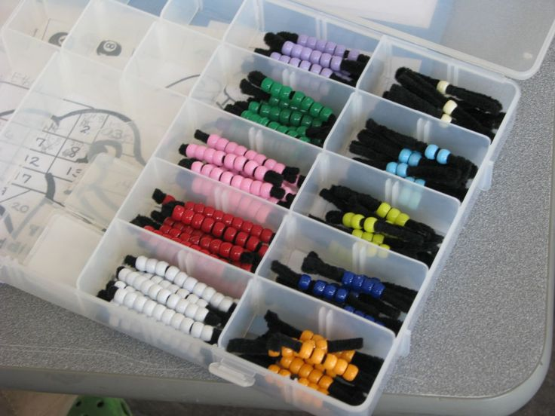

Slide 11
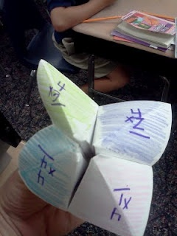
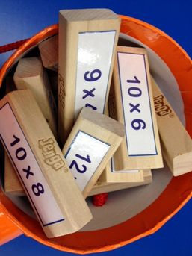

Slide 12
